Slide 1
How do changes in key macroeconomic variables affect stock returns of ASX-200 constituents from 2014-2024, and to what extent do these effects challenge the assumptions of the Efficient Market Hypothesis?
Sharna McClure
Matthew Versace
Ciara Stevens-Baytopp

Slide 2
Research Question
Our research question is:
How do changes in key macroeconomic variables affect stock returns of ASX-200 constituents from 2014-2024, and to what extent do these effects challenge the assumptions of the Efficient Market Hypothesis?
By definition, the Efficient Market Hypothesis (EMH) is a financial theory that suggests that asset prices, like stocks, completely and immediately reflect all available information at any point in time. As prices immediately adjust to new information, this theory implies that consistently staying ahead of the market on a risk-adjusted basis is impossible (Fama, 1970).

Slide 3
Why it Matters
Firstly, there have been many economic disruptors that have caused substantial market volatility between 2014-2024. Our research analyses these occurrences and provided strong-real world context for testing if Australian financial markets actually react immediately and behave efficiently.
The accuracy of the EMH for investors, firms and policymakers is very important. If macroeconomic variables consistently predict stock returns,we can assume that by using publicly available economic information investors could gain abnormal returns thus challenging the EMH. There are flow on impacts in the real world like financial portfolio management (Beechey et al., 2000).
There are very few studies on Australian Market Efficiency as most financial literature is based off on US or European markets. However, Australia is a smaller, relatively resource dependent economy, which may react differently to macroeconomic shocks in comparison to larger, more global economies (Chiah et al., 2018).

Slide 4
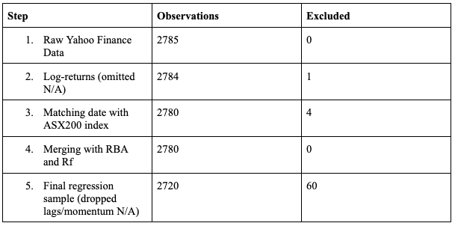
Data
Quantmod
Readrba
Figure 1: Data exclusion table

Slide 5

Empirical Strategy
Original CAPM:
Multi-Factor CAPM:
Momentum: 20-Day cumulative log return (Jegadeesh & Titman, 1993
Overreaction: Returns exceeded or were below 2 standard deviations from the mean (binary variable)

Slide 6
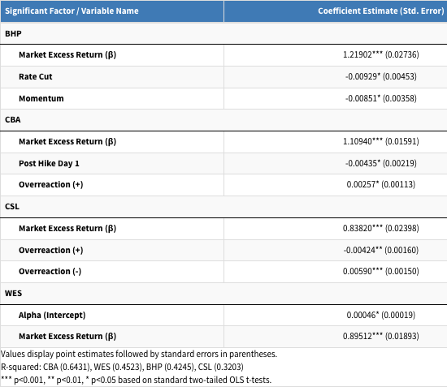
Main Results
WES is expected to have a return that is 0.0464% per day higher than the CAPM predicts
We find that a 1% increase in market excess returns is associated with an estimated β increase a securities excess returns, ceteris paribus.
CBA excess returns are on average 0.43% lower on the day following an RBA rate increase
BHPs excess returns are on average 0.93% lower on days when the RBA has cut the interest rate.
For BHP, a one unit increase in the 20-day cumulative log return is, ceteris paribus, associated with a 0.85 percent decrease in BHP excess returns the following day
Figure 2: Main regression results

Slide 7
Robustness
Limitations
1. Newey-West HAC
Heteroskedasticity detected
Autocorrelation detected
Several coefficients lost significance/weakened
2. Post-COVID Subsample
Findings changed after 2021
Sensitive to macroeconomic regime
3. Alternative Specification
Basis-point specification
Limited additional significance
Conclusions broadly unchanged
1. CAPM is a simplified asset pricing model
2. Possible omitted variable bias
3. RBA decisions partially anticipated
4. Daily data cannot isolate all events
5. Only sampled 4 firms

Slide 8
Conclusion and next steps
Overall: Australian equity markets appear broadly efficient, but temporary inefficiencies may emerge under specific macroeconomic and behavioural conditions
Main conclusions:
Systematic market risk (𝛽) consistently explained stock returns
Some firms displayed delayed reactions to RBA announcements
Behavioural effects suggested temporary return predictability
Evidence against EMH was stock specific and conditional
Next steps:
Fama-French multifactor models
Intraday event analysis
Larger cross-sectional sample

Slide 9
References
Beechey, M., Gruen, D., & Vickery, J. (2000). THE EFFICIENT MARKET HYPOTHESIS: A SURVEY. https://www.rba.gov.au/publications/rdp/2000/pdf/rdp2000-01.pdf
Chiah, M., Gharghori, P., & Zhong, A. (2018). Comovement in Anomalies between the Australian and US Equity Markets. International Review of Finance. https://doi.org/10.1111/irfi.12249
Fama, E. (1970). Efficient Capital markets: a Review of Theory and Empirical Work. The Journal of Finance, 25(2), 383–417. https://doi.org/10.2307/2325486

